Slide 1
Python List Comprehensions – Part 4
COP 4020
University of Central Florida

Slide 2
Normal, Iterative Approach
>>> mystring = "hello"
>>> mylist = []
>>> for letter in mystring:
mylist.append(letter)
>>> mylist
['h', 'e', 'l', 'l', 'o']

Slide 3
As a List Comprehension
>>> mystring = "hello"
>>> mylist = [letter for letter in mystring]
>>> print(mylist)
['h', 'e', 'l', 'l', 'o']

Slide 4
More
>>> mylist = [x for x in 'word']
>>> print(mylist)
['w', 'o', 'r', 'd’]
>>> mylist = [x for x in range(0,11)]
>>> print(mylist)
[0, 1, 2, 3, 4, 5, 6, 7, 8, 9, 10]

Slide 5
More
>>> mylist = [x**2 for x in range(0,11)]
>>> print(mylist)
[0, 1, 4, 9, 16, 25, 36, 49, 64, 81, 100]
>>> mylist = [x for x in range(0,11) if x%2 == 0]
>>> print(mylist)
[0, 2, 4, 6, 8, 10]

Slide 6
More
>>> celsius = [0,10,20,34.5]
>>> fahrenheit = [((9/5)*temp+32) for temp in celsius]
>>> print( fahrenheit)
[32.0, 50.0, 68.0, 94.1]
>>> results = [x if x%2==0 else 'ODD' for x in range(0,11)]
>>> print(results)
[0, 'ODD', 2, 'ODD', 4, 'ODD', 6, 'ODD', 8, 'ODD', 10]

Slide 7
Embedded
>>> mylist = []
>>> for x in [2,4,6]:
for y in [1,10,100]:
mylist.append(x*y)
>>> print(mylist)
[2, 20, 200, 4, 40, 400, 6, 60, 600]

Slide 8
Embedded List Comprehension
>>> mylist = [x*y for x in [2,4,6] for y in [1,10,1000]]
>>> print(mylist)
[2, 20, 2000, 4, 40, 4000, 6, 60, 6000]

Slide 9
Calling Functions
>>> def squareIt( n ):
return n ** 2
>>> mylist = [squareIt(x) for x in [1,2,3,4,5]]
>>> print(mylist)
[1, 4, 9, 16, 25]

Slide 10
Using Lambdas
>>> mylist = [(lambda x: x**2)(x) for x in range(10)]
>>> print(mylist)
[0, 1, 4, 9, 16, 25, 36, 49, 64, 81]

Slide 11
Wrapping List Comprehension in Function
>>> def func(y):
return [x for x in range(y+1)]
>>> func(17)
[0, 1, 2, 3, 4, 5, 6, 7, 8, 9, 10, 11, 12, 13, 14, 15, 16, 17]
Note: Could also be as follows:
def func(y): return [x for x in range(y+1)]

Slide 12
Create Sets
def func(y):
return {x for x in range(y+1)}

Slide 13
Back to Early Example
>>> mylist = [1,2,3,4,5,6]
>>> [x**2 for x in mylist]
[1, 4, 9, 16, 25, 36]

Slide 14
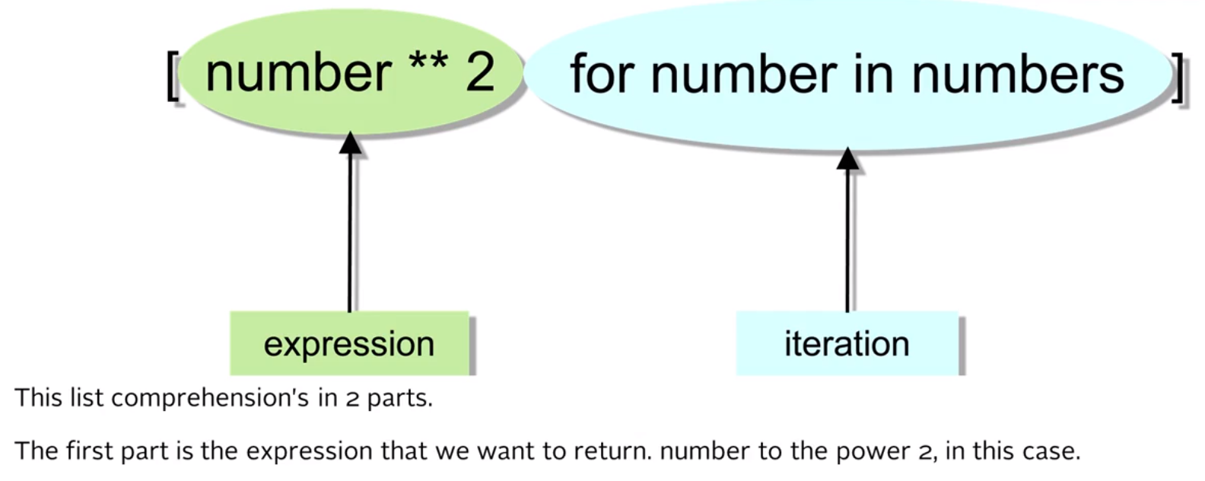

Slide 15
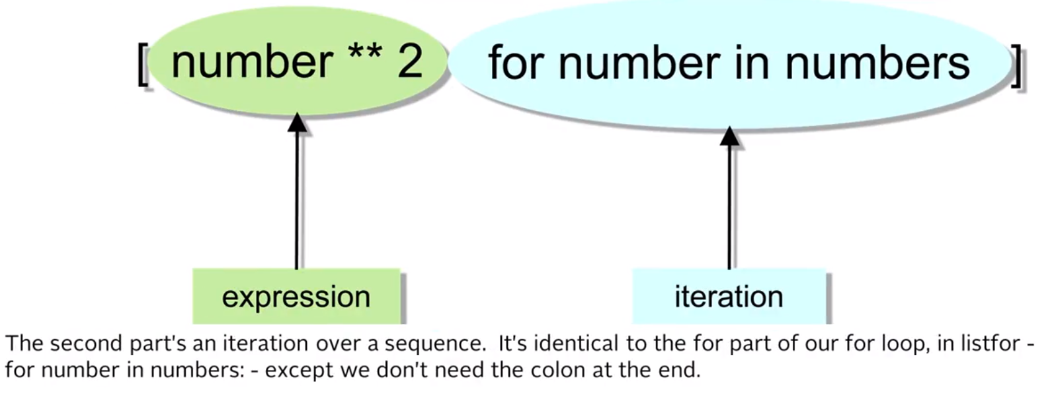

Slide 16
Multiples of 3 and 5
If we list all the natural numbers below 10 that are multiples of 3 or 5, we get 3, 5, 6 and 9. The sum of these multiples is 23.
Find the sum of all the multiples of 3 or 5 below 1000.
The following slides are the steps I took to find the solution

Slide 17
Create a Basic Function
def multiplesOf3And5( max ):
return [x for x in range(1,max+1)]
print( multiplesOf3And5(20))

Slide 18
Filter the Results
def multiplesOf3And5( max ):
return [x for x in range(1,max+1) if x%3==0 or x%5==0 ]
print( multiplesOf3And5(20))

Slide 19
Return the Sum Below 1000
def multiplesOf3And5( max ):
return sum( [x for x in range(1,max+1) if x%3==0 or x%5==0 ] )
print( multiplesOf3And5(999))
233168

Slide 20
Even Fibonacci Numbers
Each new term in the Fibonacci sequence is generated by adding the previous two terms. By starting with 1, 1, and 2, the first 10 terms will be:
1, 1, 2, 3, 5, 8, 13, 21, 34, 55, ...
By considering the terms in the Fibonacci sequence whose values do not exceed four million, find the sum of the even-valued terms.
The next slides show my solution

Slide 21
Creating the Fibonacci List
def evenFibs( maxValue ):
series=[1,1]
[series.append(series[k-1]+series[k-2]) for k in range(2,maxValue)]
return series
print( evenFibs( 40 ) )

Slide 22
Reuse the fibList function
def fibList( max ):
list = [1,1,2]
def nextFib( f, s, mx ):
if f + s >= mx:
return
else:
list.append( f + s )
nextFib( s, f+s, mx )
nextFib(1,2,max)
return list

Slide 23
Create a List Comprehension-Based Function that uses fibList
def evenFibs( max ):
return max [x for x in fibList( max ) if x%2==0]
Test:
print( evenFibs( 4000000 ) )

Slide 24
Largest Palindrome Product
A palindromic number reads the same both ways. The largest palindrome made from the product of two 2-digit numbers is 9009 = 91 × 99.
Find the largest palindrome made from the product of two 3-digit numbers.

Slide 25
Reuse isPalindrome
def isPalindrome( num ):
first = str(num)
second = first[::-1]
return first == second

Slide 26
Create Function
def largestPalindrome( start, end ):
mylist = []
[mylist.append(x*y) for x in range( start, end+1) for y in range( start, end+1) if isPalindrome(x*y)]
return max(mylist)
Test:
print( largestPalindrome( 10, 99 ) )
print( largestPalindrome( 100, 999 ) )

Slide 27
Generators
Comparing memory
range() is a generator
import sys
big_range = range(1000)
print("big_range is {} bytes".format(sys.getsizeof(big_range)))
big_list = []
for val in big_range:
big_list.append(val)
print("big_list is {} bytes".format(sys.getsizeof(big_list)))
big_range is 24 bytes
big_list is 4516 bytes

Slide 28
Refactored
import sys
def my_range(n: int):
start = 0
while start < n:
yield start
start += 1
big_range = my_range(1000)
print("big_range is {} bytes".format(sys.getsizeof(big_range)))
big_list = []
for val in big_range:
big_list.append(val)
print("big_list is {} bytes".format(sys.getsizeof(big_list)))
big_range is 64 bytes
big_list is 4516 bytes

Slide 29
Using Next
You can manually step through an iterable item as follows
def my_range(n: int):
start = 0
while start < n:
yield start
start += 1
mylist = my_range(1000)
print(next(mylist))
print(next(mylist))
print(next(mylist))
print(next(mylist))
0
1
2
3

Slide 30
Swapping
There is a python trick for swapping values:
a = 2
b = 3
print("a is {}, b is {}".format(a,b));
a,b=b,a
print("a is {}, b is {}".format(a,b));
a is 2, b is 3
a is 3, b is 2

Slide 31
Yet Another Fibonacci
def fibonacci():
current, previous = 0, 1
while True:
current, previous = current + previous, current
yield current
fib = fibonacci()
print( next( fib ) )
print( next( fib ) )
print( next( fib ) )
print( next( fib ) )
print( next( fib ) )
print( next( fib ) )
print( next( fib ) )
print( next( fib ) )
print( next( fib ) )
1
1
2
3
5
8
13
21
34

Slide 32
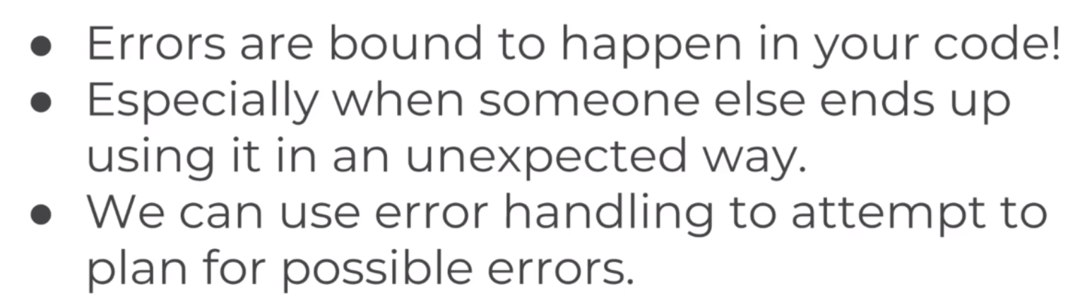
Errors and Exception Handling

Slide 33
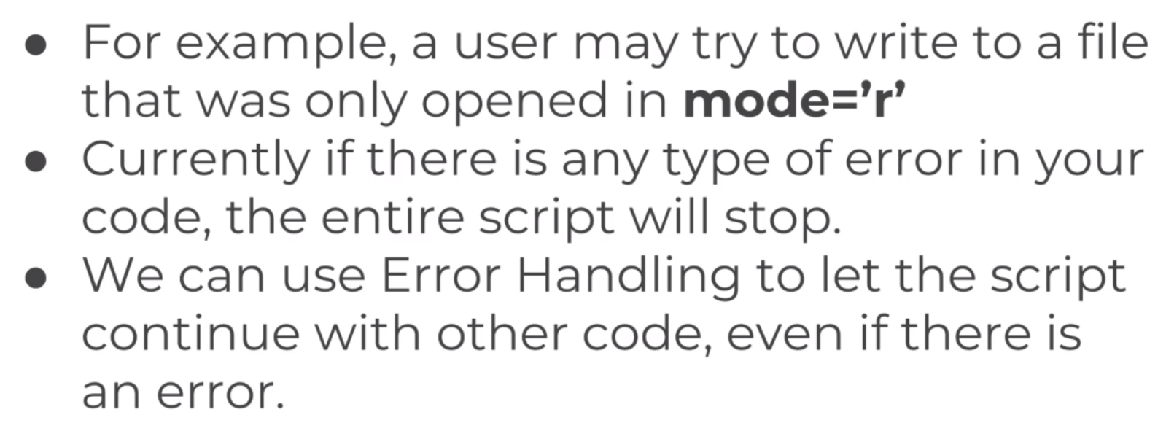

Slide 34
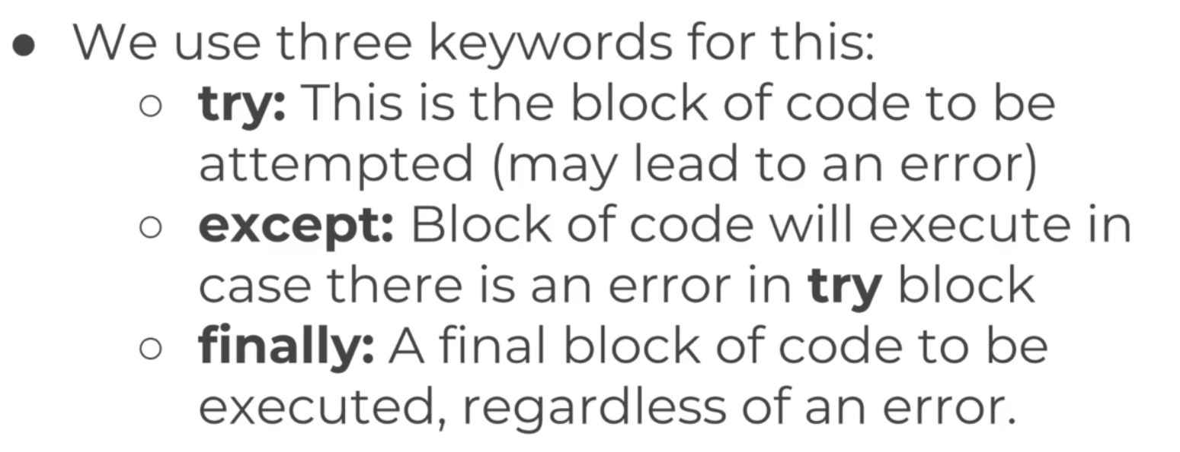

Slide 35
Examples
def add(n1,n2):
print(n1+n2)
add(10,20)

Slide 36
Examples
def add(n1,n2):
print(n1+n2)
number1 = 10
number2 = 20
add(number1,number2)

Slide 37
Taking Input
def add(n1,n2):
print(n1+n2)
number1 = 10
number2 = input("Please enter a number:")
add(number1,number2)
TypeError: unsupported operand type(s) for +: 'int' and 'str'
Please enter a number: 20

Slide 38

Syntax Errors
Syntax errors, also known as parsing errors, are perhaps the most common kind of error you encounter while you are still learning Python.
The parser repeats the offending line and displays a little ‘arrow’ pointing at the earliest point in the line where the error was detected. The error is detected at the token preceding the arrow. File name and line number are printed so you know where to look in case the input came from a script.

Slide 39
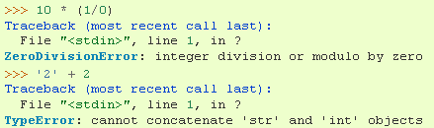
Exceptions
Even if a statement or expression is syntactically correct, it may cause an error when an attempt is made to execute it. Errors detected during execution are called exceptions and are not unconditionally fatal. Most exceptions are not handled by programs, however, and result in error messages like “cannot divide by zero” or “cannot concatenate ‘str’ and ‘int’ objects”.

Slide 40
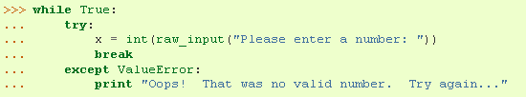
Handling Exceptions
It is possible to write programs that handle selected exceptions. Consider the following, where a user-generated interruption is signaled by raising the KeyboardInterrupt exception.
First the 'try' clause is executed until an exception occurs, in which case the rest of 'try' clause is skipped and the 'except' clause is executed (depending on type of exception), and execution continues. If an exception occurs which does not match the exception named in the except clause, it is passed on to outer try statements; if no handler is found, it is an unhandled exception and execution stops.

Slide 41
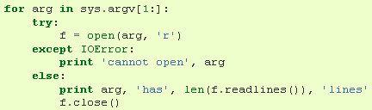
The last except clause (when many are declared) may omit the exception name(s), to serve as a wildcard. This makes it very easy to mask a real programming error. It can also be used to print an error message and then re-raise the exception.
The try-except statement has an optional else clause, which, when present, must follow all except clauses. It is useful for code that must be executed if the try clause does not raise an exception.

Slide 42

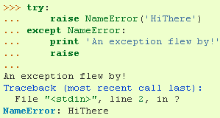
Raising Exceptions
The raise statement allows the programmer to force a specified exception to occur.
The sole argument to raise indicates the exception to be raised.
A simpler form of the raise statement allows one to re-raise the exception (if you don’t want to handle it):

Slide 43
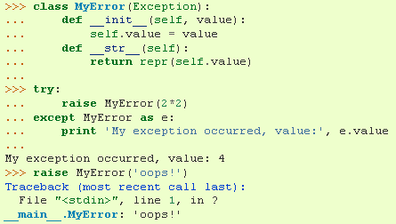
User-defined Exceptions
Programs may name their own exceptions by creating a new exception class. These are derived from the Exception class, either directly or indirectly.
Here, the def__init__() of Exception has been overridden. The new behavior simply creates the value attribute.

Slide 44
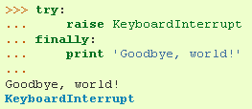
Defining Clean-up Actions
The try statement has another optional clause which is intended to define clean-up actions that must be executed under all circumstances.
A finally clause is executed before leaving the try statement, whether an exception has occurred or not. When an exception has occurred in the try clause and has not been handled by an except clause, it is re-raised after the finally clause has been executed. The finally clause is also executed “on the way out” when any other clause of the try statement is exited using break/continue/return.

Slide 45


Predefined Clean-up Actions
Some objects define standard clean-up actions to be undertaken when the object is no longer needed, regardless of whether or not the operation using the object succeeded or failed.
The problem with this code is that it leaves the file open for an indefinite amount of time after the code has finished executing.
The ‘with’ statement allows objects like files to be used in a way that ensures they are always cleaned up promptly and correctly.

Slide 46
The Following Slides Contains Opinions for Discussion

Slide 47
The idea behind "catch late" is, rather than catching as late as possible, to catch as early as is useful.
If you have a file parser, for example, there's no point handling a file not found.
What are you meant to do with that, what is your recovery path?
There isn't one, so don't catch.
Go to your lexer, what do you do there, how do you recover from this such that your program can continue?
It can't, let the exception pass.
How can your scanner handle this?
It can't, let it pass.
How can the calling code handle this?
It can either try another filepath or alert the user, so catch.

Slide 48
Just a reminder for anyone reaching to this question and doing
Android development.
On Android, exceptions must be caught and handled locally - in the same function where it is first caught.
This is because exceptions don't propagate across message handlers - your application will be killed if it happens.
So, you should not cite this advice when doing Android development.

Slide 49
In my experience, its best to throw exceptions at the point where the errors occur.
You do this because it's the point where you know the most about why the exception was triggered.
As the exception unwinds back up the layers, catching and rethrowing is a good way to add additional context to the exception.
This can mean throwing a different type of exception, but include the original exception when you do this.
Eventually the exception will reach a layer where you are able to make decisions on code flow (e.g a prompt the user for action).
This is the point where you should finally handle the exception and continue normal execution.

Slide 50
With practice and experience with your code base it becomes quite easy to judge when to add additional context to errors, and where it's most sensible to actually, finally handle the errors.
Catch → Rethrow
Do this where you can usefully add more information that would save a developer having to work through all the layers to understand the problem.
Catch → Handle
Do this where you can make final decisions on what is an appropriate, but different execution flow through the software.
Catch → Error Return
Whilst there are situations where this is appropriate, catching exceptions and returning an error value to the caller should be considered for refactoring into a Catch → Rethrow implementation.

Slide 51
You want to throw an exception as soon as possible because that makes it easier to find the cause.
For example, consider a method that could fail with certain arguments.
If you validate the arguments and fail at the very beginning of the method, you immediately know the error is in the calling code.
If you wait until the arguments are needed before failing, you have to follow the execution and figure out if the bug is in the calling code (bad argument) or the method has a bug.
The earlier you throw the exception, the closer it is to its underlying cause and the easier it is to figure out where things went wrong.

Slide 52
The reason exceptions are handled at higher levels is because the lower levels don't know what's the appropriate course of action to handle the error.
In fact, there could be multiple appropriate ways to handle the same error depending on what the calling code is.
Take opening a file for example. If you're trying to open a config file and it's not there, ignoring the exception and proceeding with the default configuration can be an appropriate response.
If you're opening a private file that's vital to the program's execution and it's somehow missing, your only option is probably to close the program.

